Slide 1
Smart Reply: Automated Response Suggestion for Email
Speaker: Jim-An Tsai
Advisor: Professor Jia-ling Koh
Author: Anjuli Kannan, Karol Kurach, Sujith Ravi, Tobias Kaufmann, Andrew Tomkins, Balint Miklos, Greg Corrado, Laszlo Lukacs, Marina Ganea,Peter Young, Vivek Ramavajjala
Date:2017/4/25
Source: KDD ’16

Slide 2
Outline
Introduction
Method
Experiment
Conclusion

Slide 3
Motivation

Slide 4
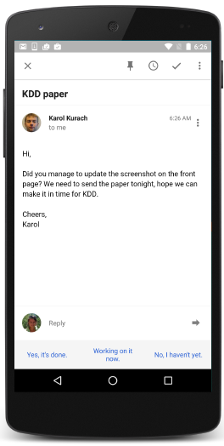
Purpose

Slide 5
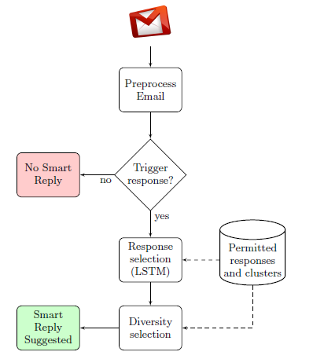
Framework

Slide 6
Outline
Introduction
Method
Experiment
Conclusion

Slide 7
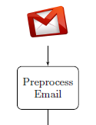
Preprocessing
When email message input, it will do
1. Language detection:排除英文之外的語言
2. Tokenization:將信件主題跟信件內容都切成words和標點符號。
3. Sentence segmentation:將sentences分段
4. Normalization:將人名、URL連接…等用一個特殊符號取代
5. Quotation removal:引用的內容移除
6. Salutation/close removal:稱謂移除

Slide 8
Challenges
Response quality
How to ensure that the individual response options are always high quality in language and content.
Utility
How to select multiple options to show a user so as to maximize the likelihood that one is chosen.
Scalability
How to efficiently process millions of messages per day while remaining within the latency requirements of an email delivery system.
Privacy
How to develop this system without ever inspecting the data except aggregate statistics.

Slide 9
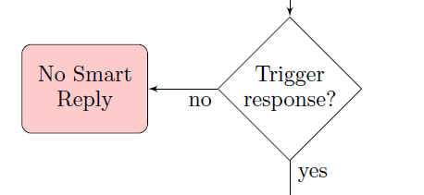
Triggering
The triggering module is the entry point of the Smart Reply system.
Not all emails need response suggestions.(eg. Promotional emails, open-ended questions…etc)
Based on feedforward neural network[9]
>>Produces a probability score for every incoming message. If the score is above some threshold, we trigger and run the LSTM scoring.
Notes:
它的輸出值只取決於目前時刻的輸入值，這樣的類神經網路稱為 feedforward neural network 。
https://www.itsfun.com.tw/%E5%89%8D%E9%A5%8B%E7%A5%9E%E7%B6%93%E7%B6%B2%E8%B7%AF/wiki-1552427-5569107#感知器

Slide 10
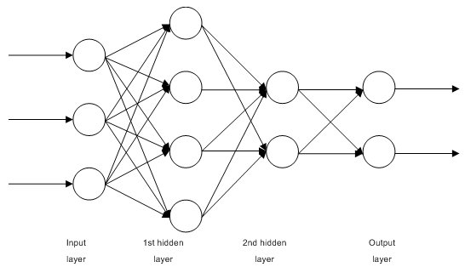
Triggering
The goal is to model P(y = true|o), the probability that message o will have a response on mobile.(y=(true,false), o = incoming messages).
Training features: content features(eg: unigram, bigrams)from the message body, subject and headers.
feedforward neural network
Notes:
它的輸出值只取決於目前時刻的輸入值，這樣的類神經網路稱為 feedforward neural network 。
https://en.wikipedia.org/wiki/Feedforward_neural_network

Slide 11
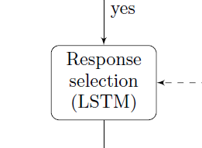
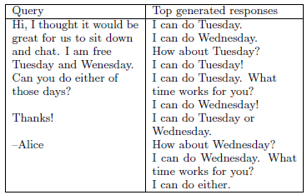
Response selection(LSTM)
Example:

Slide 12
Response selection(LSTM)
LSTM model:
Training:
o: original messages, r: possible responses
Notes:
http://www.zmonster.me/notes/sequence_to_sequence_learning.html
http://www.zmonster.me/2016/05/29/sequence_to_sequence_with_keras.html

Slide 13
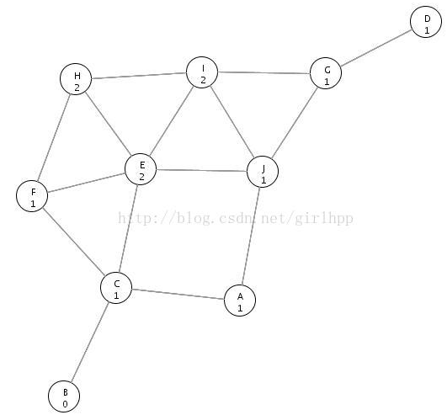
Response selection(LSTM)
Inference(using beam search):
Beam Search:
Notes:
http://blog.csdn.net/girlhpp/article/details/19400731

Slide 14
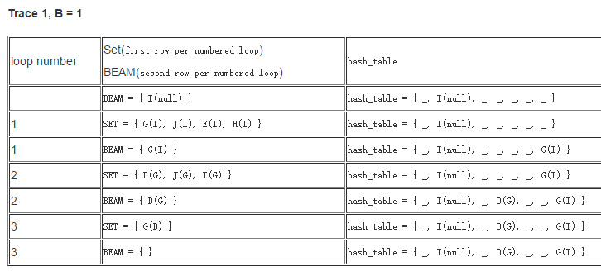
Response selection(LSTM)
Beam Search:

Slide 15
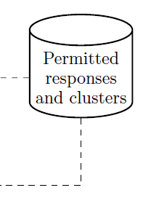
Permitted responses and clusters
1. Canonicalizing email responses
Ex: “Thanks for your kind update.”, “Thank you for updating.” means the same information.
>>using dependency parser to generate a canonicalized representation.

Slide 16
Permitted responses and clusters
2. Semantic intent clustering
Ex: “ha ha”, “lol”, “Oh that’s funny!”>> funny cluster
Using scalable graph algorithm[15]
3. Graph construction
Purpose: construct a based graph with frequent response messages.
Ex:

Slide 17
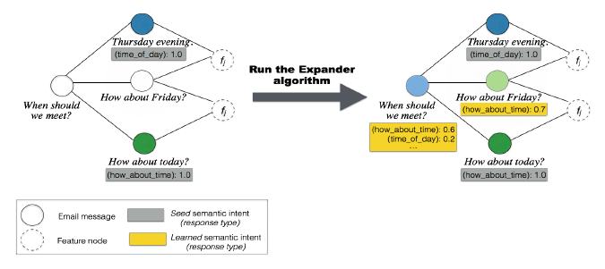
Permitted responses and clusters
4. Semi-supervised Learning
using EXPANDER[15] for optimization

Slide 18
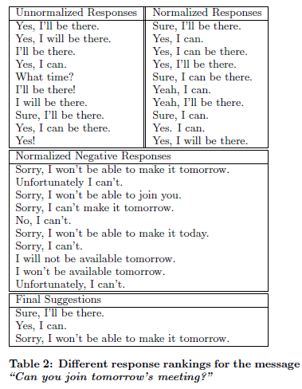
Diversity selection

Slide 19
Outline
Introduction
Method
Experiment
Conclusion

Slide 20
Data Set
Training set:
238 million messages, including 153 million messages that have no responses

Slide 21
Results for Triggering
Split the data set to Train80%, Test 20%
AUC of the triggering model is 0.854.

Slide 22
Results for Response selection
Perplexity is a measure of how well the model has fit the data: a model with lower perplexity assigns higher likelihood to the test responses, so we expect it to be better at predicting responses.
The perplexity of the Smart Reply LSTM is 17.0.
an n-grams language model with Katz backoff [11] and a maximum order of 5 has a perplexity of 31.4 on the same data.
Response ranking

Slide 23
Results for diversity

Slide 24
Outline
Introduction
Method
Experiment
Conclusion

Slide 25
Conclusion
We presented Smart Reply, a novel end-to-end system for automatically generating short, complete email responses.
The core of the system is a state-of-the-art deep LSTM model that can predict full responses, given an incoming email message.

